Slide 1
Managing Change

Slide 2
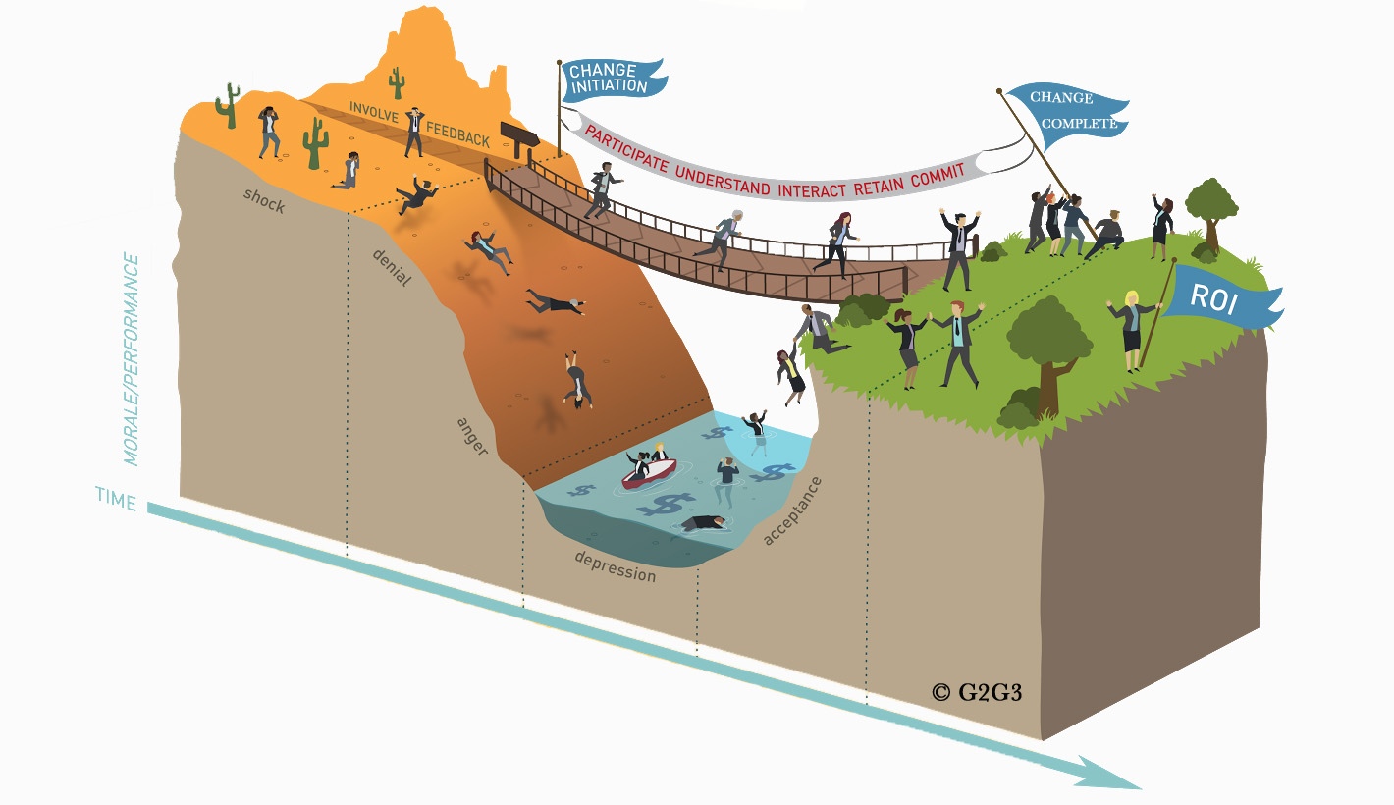
Lifecycle of Change Management and the Change Curve
Too Late
Start Change
Management Here
Bridges
Notes:
Introduce the Bridge Change Image (Change Curve + Bridges Transition Theory)
Another view into the process of change is to think about the change curve and the emotions associated as people move from the current state to the future state.
This bridge image represents the change curve that is woven together with William Bridges Transition Theory . This illustration has been really impactful for some leaders at Vizient and resonates as a visual of the journey of change.
Change is not linear
It’s important to note that this isn’t a linear process. People may slide up and down the curve several different times throughout the change.
They may be in denial one day and energetic the next day to stressed out the next day.
As leaders, our role is to create momentum for our people. We ultimately want to shift folks to the ‘right’.
We must also be aware of the fact that not everyone is moveable. As always, we want to focus on the majority and not get distracted by the individual outliers.
Change Process—Initial State (common emotions and reactions)
When standing in the orange field on the left (which represents the current state of things and all that we are saying goodbye to), there are some common human reactions you can anticipate. People might be in denial, shock, feel scared, experience anxiety, and even be angry.
It is important to recognize that individuals take change personally and each person will receive it in a slightly different way
Also, not every sign of resistance will present itself as a vocal or an angry mob…some resistance is less obvious.
Not only will it be important to listen to what your teams are saying it is also very important to watch how they are behaving.
Change Process—Transition State (common emotions and reactions)
As people come near the edge of the orange field and put their toes on the bridge and begin to walk across, they are in the neutral zone or transition state of change.
They may be confused as to why the change is needed
They may feel additional stress as nothing looks or feels like it used to.
They may need to solve what might be called an internal Approach-Avoidance conflict.
As an example – if I am making a decision to take a new job that brings a greater salary and more prestige, but also contains a great deal of stress and long hours. I need to determine for myself whether the negative aspects outweigh the positives before I can move to the future state.
In other words, do I see the benefits of walking across the bridge and leaning into the change? This conflict inside needs to be resolved in order to adopt the change.
Change Process—Future State (common emotions and reactions)
Once you are over the bridge, your feet land on green soil and enter the land of New Beginnings and in the change curve, the future state.
People will not only accept the change but embrace it (or as I said earlier—LEAN INTO THE CHANGE)
They can then start to restructure their ways of working and become more productive and positive.
You will notice more energy and enthusiasm in people in this stage.
Group discussion: Curious where you all are personally on the change bridge?

Slide 4
Check-in:
Where are you at today?

Slide 5
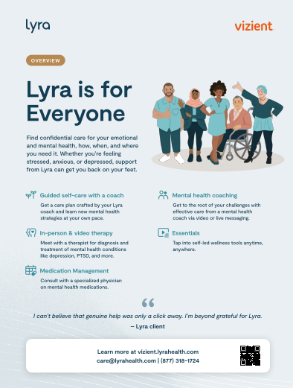
Employee Assistance Program (EAP)

